Slide 1
Module 7

Slide 2
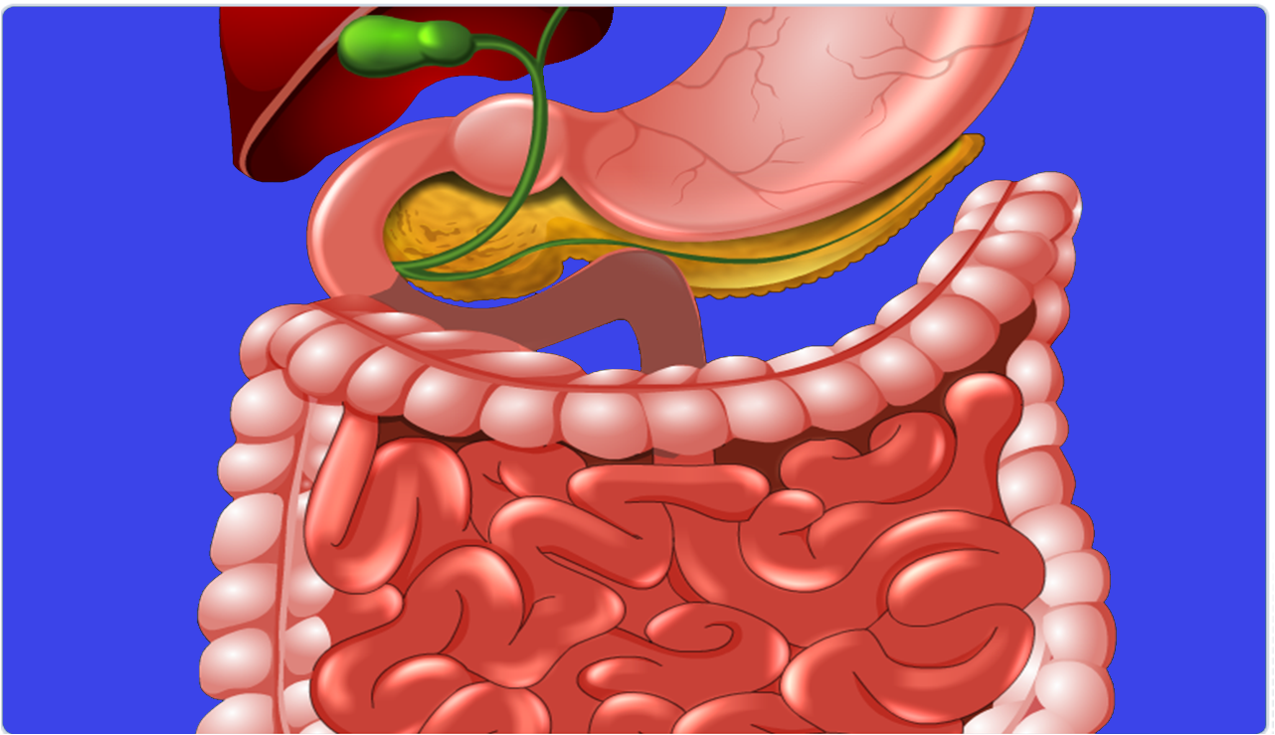
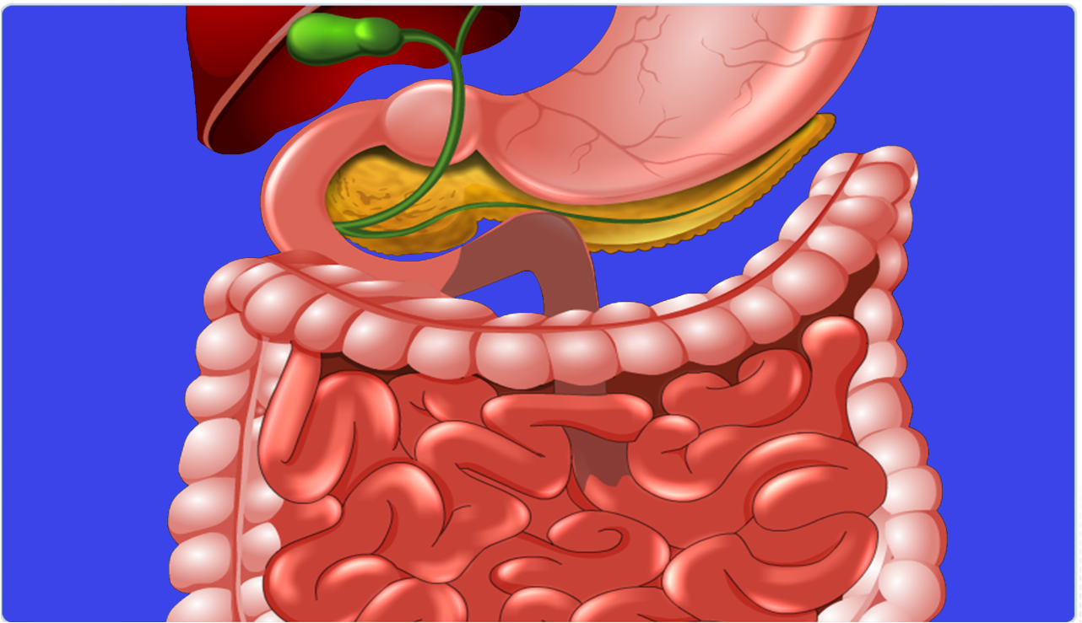
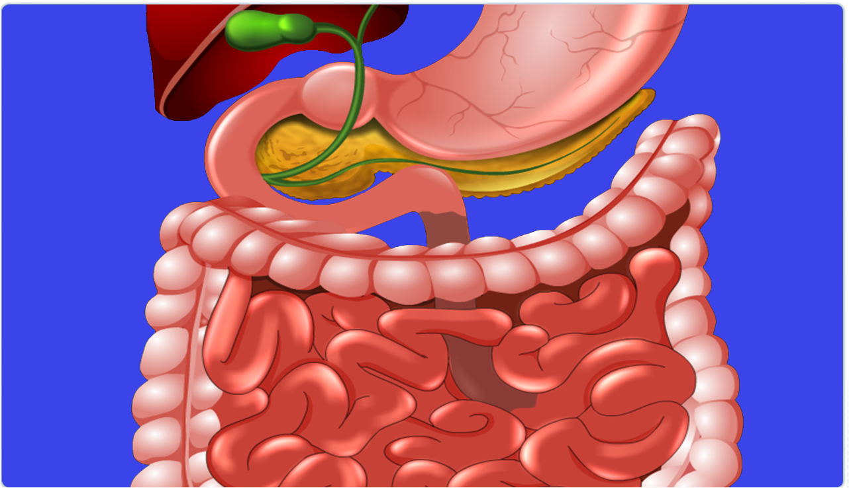
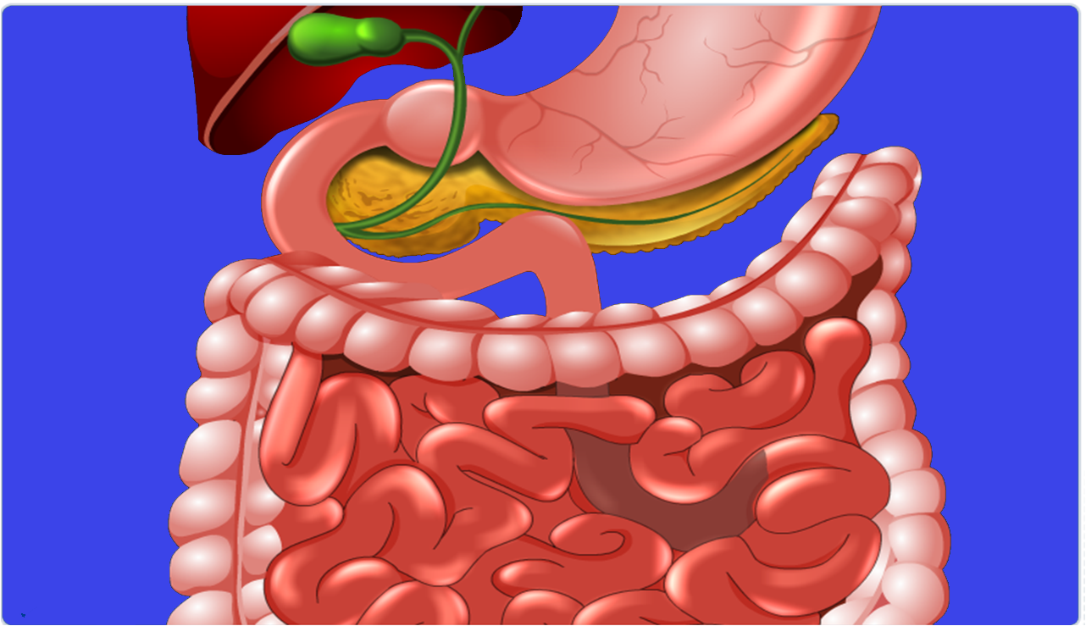
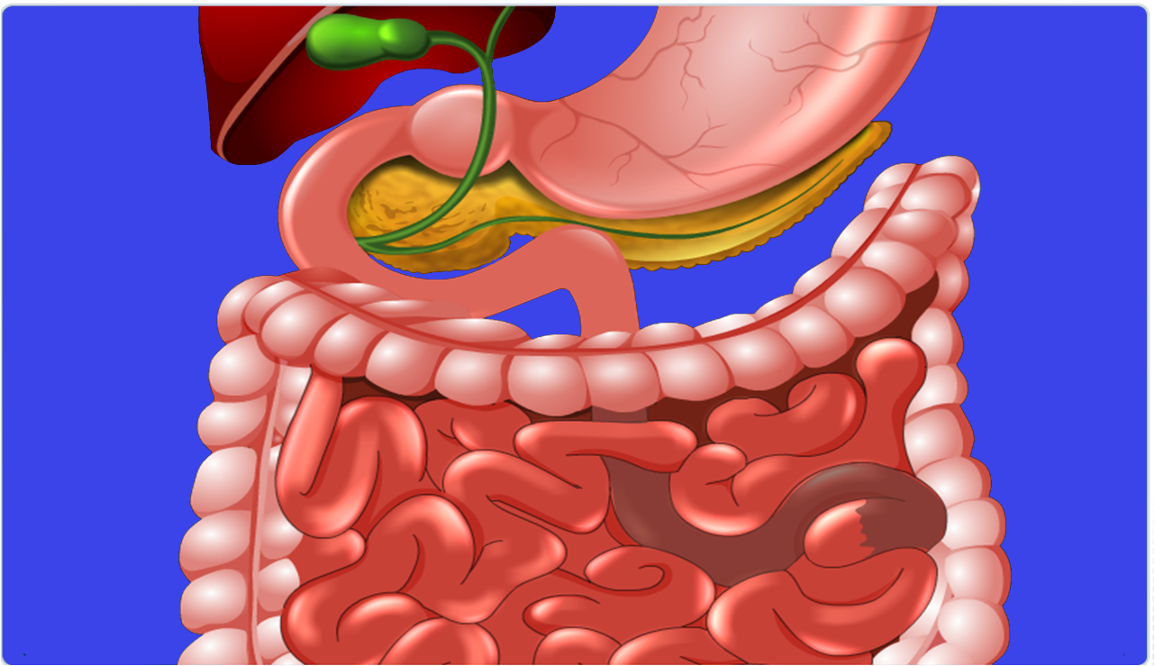
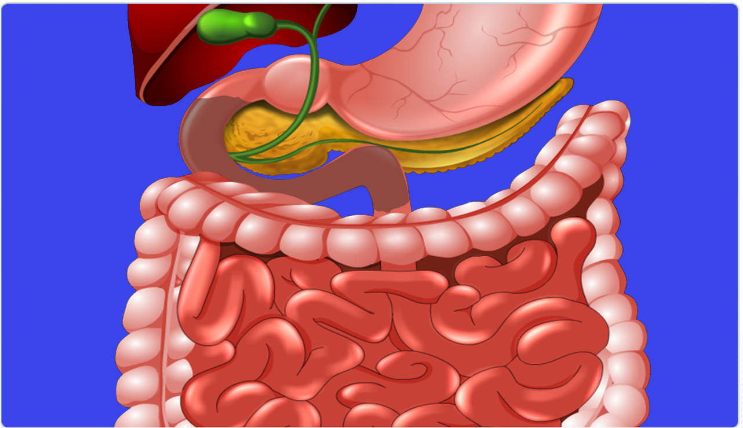
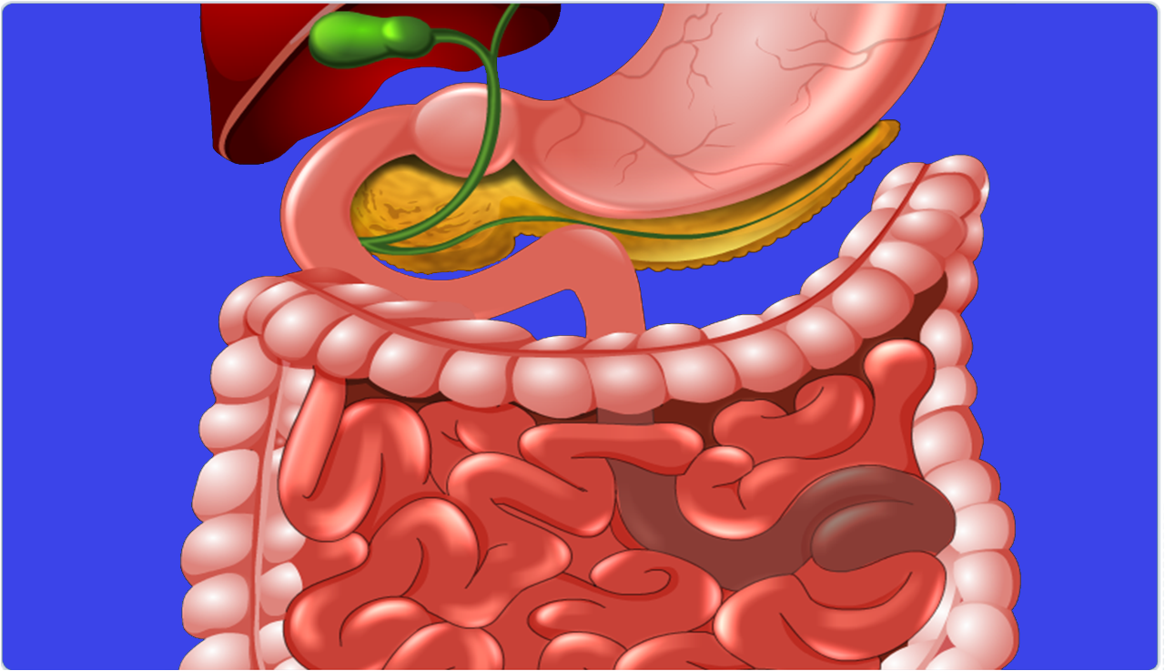
Now the digested food passes down through the small intestine.

Slide 3
Inside the small intestine there are numerous finger like projections called villi.
Villi absorb the digested food.

Slide 4
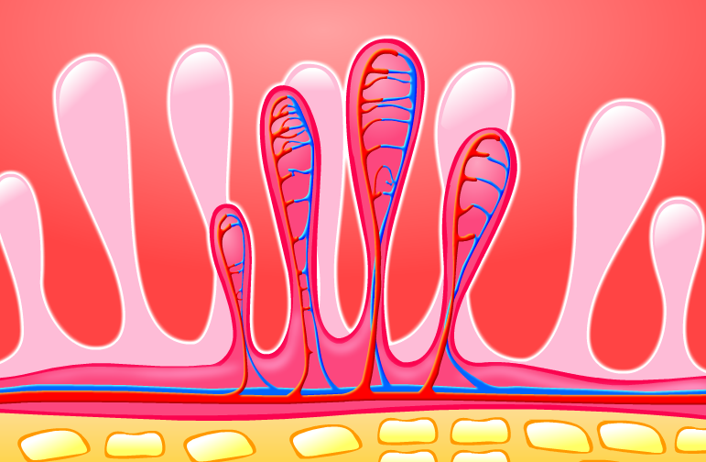
The villi are richly supplied with blood vessels.
The absorbed food is taken to each and every cell of the body where it is utilized for obtaining energy.
Blood vessels.
Cells

Slide 5
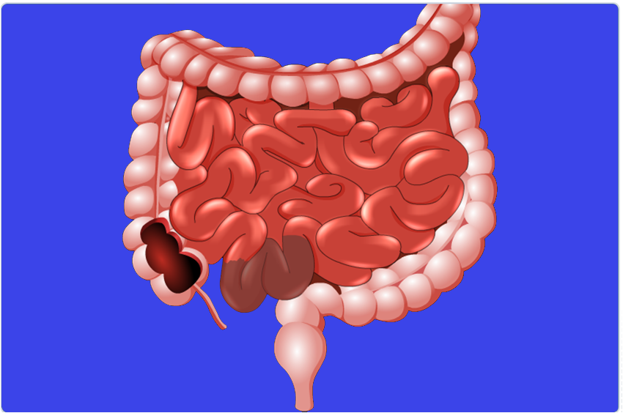

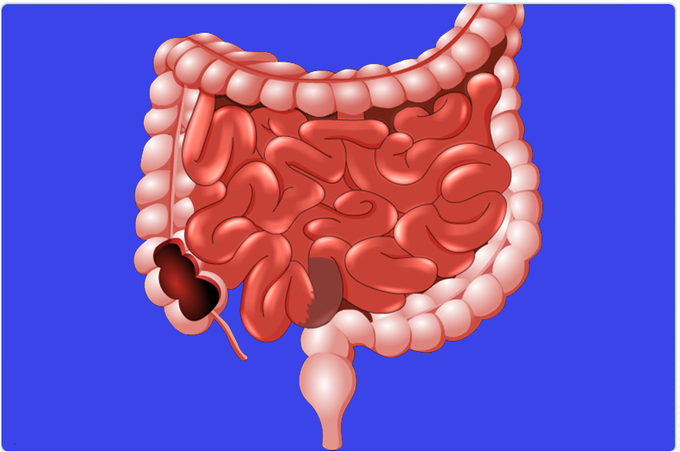



Now the unabsorbed food passes into the large intestine.

Slide 6
Large intestine does not have any
digestive functions
Finger like projections
It has VILLI that absorb water & salts
1.5 meteres
Rest of the material is removed out through
the ANUS
Anus
The exit is regulated by the muscle called Anal sphincter.
A types of muscle

Slide 7
Thank You

